Slide 1
The 36th IGC - Background
India, leading its regional partners, has won the global bid in 2012 at Brisbane to host the 36th IGC in the year 2020 in Delhi.
The title theme of the 36 IGC ‘Geosciences: The Basic Science for a Sustainable Future’
Delhi – the host city is well connected with the World by air.
It witnesses a pleasant weather in early March.
The Secretariat located in New Delhi is coordinating all activities

Slide 2
Science Program
Geosciences: The Basic Science for a Sustainable Future
Near Surface Geoscience: Earth Observation System-Climate Variables, Proxies and Modeling, Monsoon Evolution, Oceans in a Changing World, Environmental Geosciences and Critical Zone
Resource Generation: Energy Resources, Hydrocarbon Systems, Advances in Mineral Resource Evaluation, Exploration and Mining of Marine Mineral Resources, Critical Minerals, Emerging Trends in Exploration for Deep and Concealed Resources
Geoscience for Societal Use: Geoscience for Society, Geohazards, Sustainable Development and Mining, Hydrology for Sustainable Development, Engineering Geology and Rock Mechanics
The Himalayas constitute a key Indian subcontinent specific theme.
In addition, core geoscience themes remain part of the Science Program

Slide 3
Field Trip Program
Over 50 field trips showcase most of the geologically spectacular features like:
The Himalayas (2400 km long, evolving mountain chain in the Indian Subcontinent)
Deccan Flood basalts (Late Cretaceous 0.5 million sq km expanse in Western India)
Major Base metal Ore Deposits (Agucha, Rajpura Dariba, Sindeshar &Zawar Deposits)
Central Indian Tectonic Zone (An ENE-WSW trending Lineament in Central India)
Pan-African Granulite Belt in Southern India
Ultrahigh Temperature granulites (in the Eastern Ghat Mobile Belts)
The Great Sunderban Delta (in the eastern part of the Indian Subcontinent)
Rare Dinosaurian Nestling Sites (Western India)
The Indo-Gangetic Alluvium Plain (Quaternary sediments in the Himalayan foreland basin)
Fossiliferous Jurassic and Triassic formations (Western and Southern India)
In addition there are several one day and other field trips in the Indian subcontinent)

Slide 4
Venue
India Expo Centre, Greater Noida, NCR Delhi is the venue
It is a state-of-the-art centre with following facilities:
Plenary session for 8000 delegates
60+ parallel sessions with 200 capacity each
Geo Exhibition space of 25,000 sq m
Total area of 2,35,000 sq. m
14 halls, 29 meeting rooms and 3 restaurants
Conveniently located with wide options for accommodation close by

Slide 5
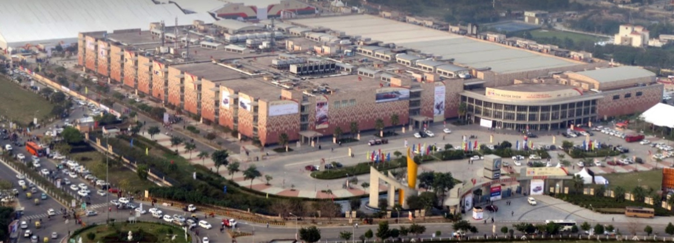
India Expo Centre

Slide 6
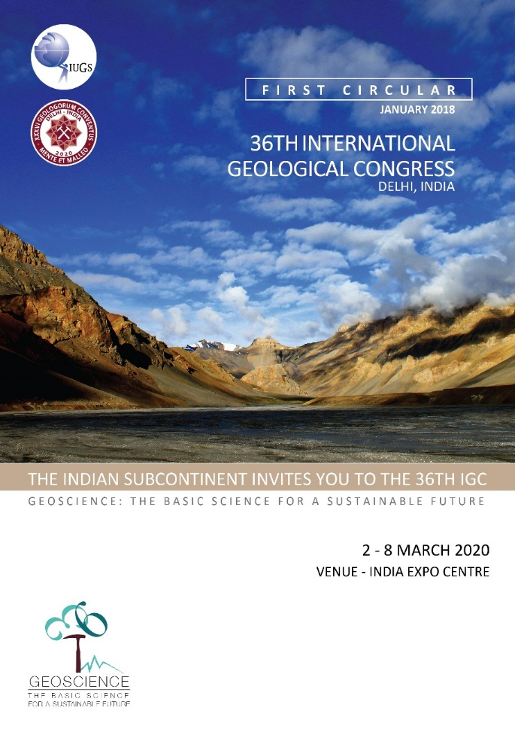
First Circular of 36th IGC released on 9th Feb.2018

Slide 7
Theme Logo of 36th IGC

Slide 8
Thank You

Slide 9
The 36th IGC – Key Functionaries
President: Prof. V. P. Dimri
Co-President: Dr. Dinesh Gupta, Director General
Secretary General: Dr. P. R. Golani
Chair, Science Program Committee: Prof. Talat Ahmad
Co-Chairs, Science Program Committee: Dr. S. K. Ray & Prof. P. P. Chakravorty
Co-Chairs Field Trip Committee: Prof. S. Dasgupta and Dr. N. R. Ramesh
Chair, Geohost: Prof. R. Shankar
Chair, Legacy: Dr. Fareeduddin
Chair Sponsorship Committee: Dr. Gopal Dhawan
YES Representative: Dr. Tanvi Arora

Slide 10
36th International Geological Congress
2-8 March, 2020
Delhi, India

